Slide 1


QUICKCAP
BY SPONGEBOB TEAM

Slide 2
INITIAL GOAL
TO CREATE A 3D ANIMATION OF A PERSON DEMONSTRATING SPECIFIC MOVEMENTS LIKE SELF-DEFENSE FOR OTHERS TO LEARN.

Slide 3
VIDEO

Slide 4
RESOURCES WE USED
WRNCH'S API
UNITY
VISUAL STUDIO

Slide 5
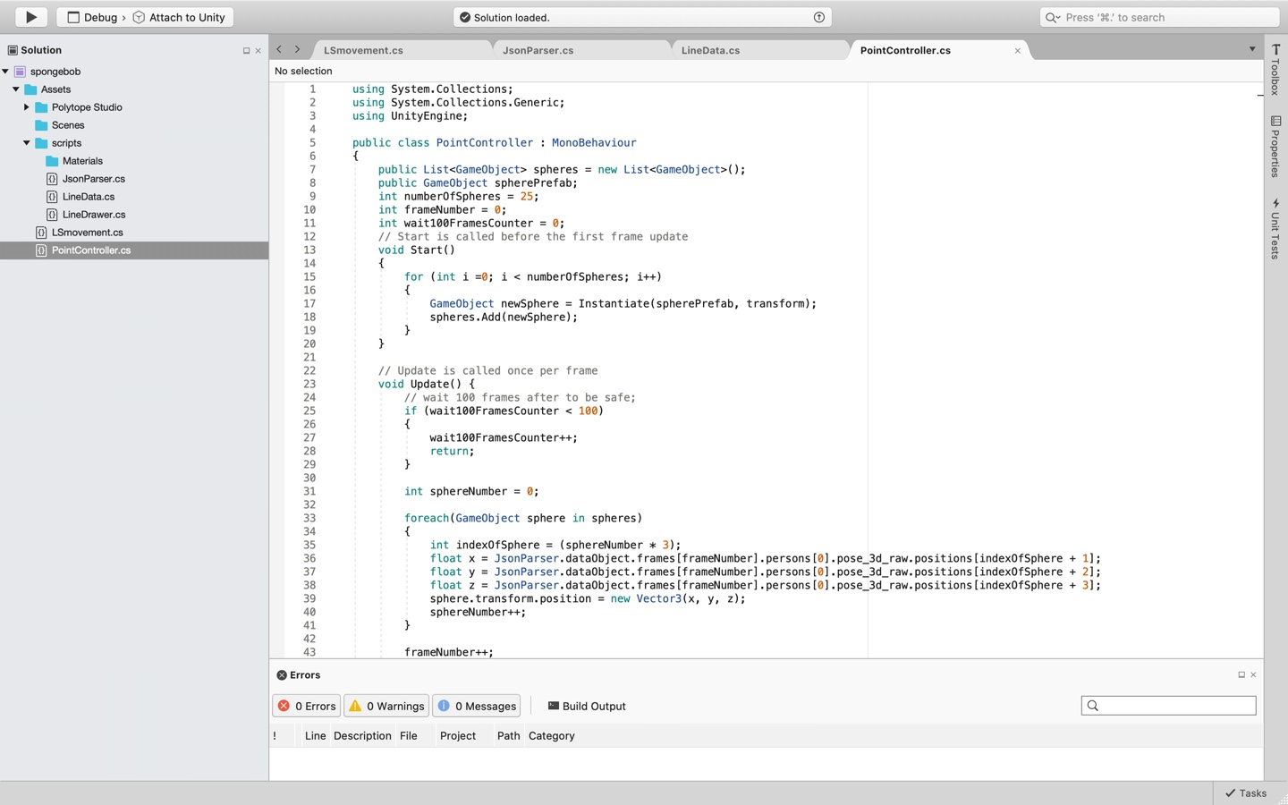
HOW WE IMPLEMENTED

Slide 6
IMPROVEMENTS
CLEARER REPRESENTATION OF THE MODEL'S BODY
CONNECTING THE PIVOT POINTS (SPHERES)

Slide 7
FUTURE DEVELOPMENT
VIDEO GAMES
USE IN MECHANIM
DEMONSTRATE MOVEMENTS
FITNESS GURU
SELF DEFENSE

Slide 8
THANK YOU

